Slide 1







World Wide
Energy
Consumption
Presented By
Name: Amol Chavan
Branch: Pune
Clean Solutions for a Greener Earth

Slide 2





ABOUT
This project analyzes the relationship between energy consumption, carbon emissions, GDP, and population across countries over time. Using SQL and data visualization tools,
DataBase:MY SQL
Tool: SQL WORKBENCH
Language: SQL

Slide 3
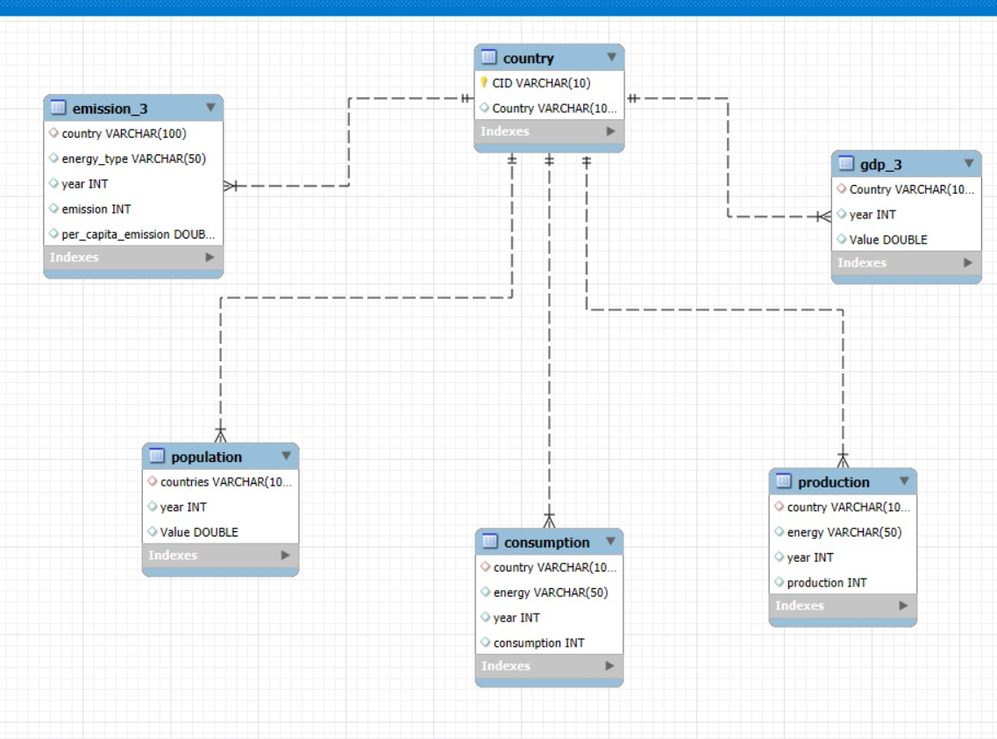





EER Diagram

Slide 4


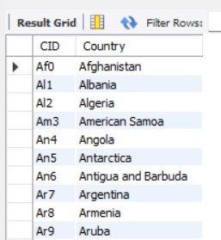




country table CREATE TABLE country (
CID VARCHAR(10) PRIMARY KEY, Country VARCHAR(100) UNIQUE
);

Slide 5


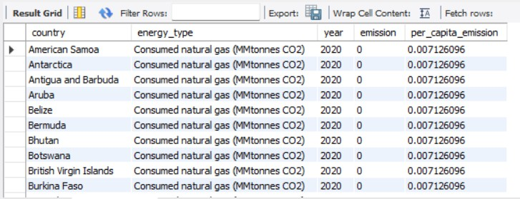

emission_3 table CREATE TABLE emission_3 (
country VARCHAR(100), energy_type VARCHAR(50), year INT,
emission INT, per_capita_emission DOUBLE,
FOREIGN KEY (country) REFERENCES
country(Country)
);

Slide 6


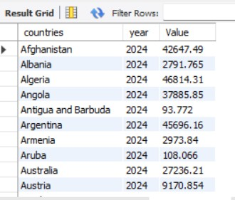

CREATE TABLE population ( countries VARCHAR(100),
year INT, Value DOUBLE,
FOREIGN KEY (countries) REFERENCES country(Country)
);

Slide 7


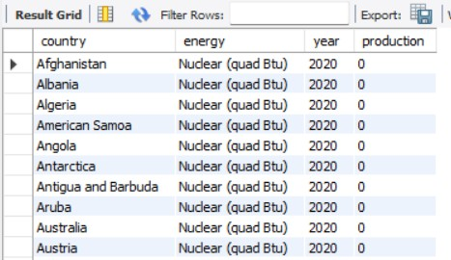

CREATE TABLE production ( country VARCHAR(100),
energy VARCHAR(50), year INT,
production INT, FOREIGN KEY (country)
REFERENCES country(Country)
);

Slide 8

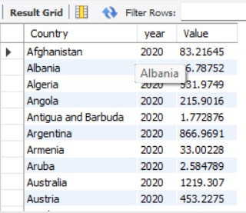

CREATE TABLE gdp_3 ( Country VARCHAR(100),
year INT, Value DOUBLE,
FOREIGN KEY (Country) REFERENCES country(Country)
);

Slide 9

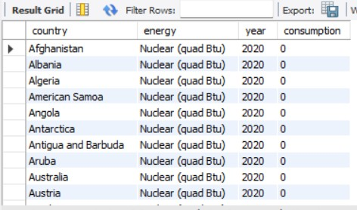

CREATE TABLE consumption ( country VARCHAR(100), energy VARCHAR(50),
year INT, consumption INT,
FOREIGN KEY (country) REFERENCES country(Country)
);

Slide 10

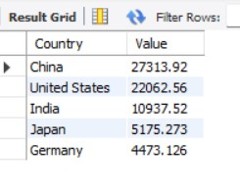

INSIGHTS
What are the top 5 countries by GDP in the most recent year?
SELECT Country,Value FROM gdp_3
WHERE year=2023 ORDER BY value DESC LIMIT
5;

Slide 11
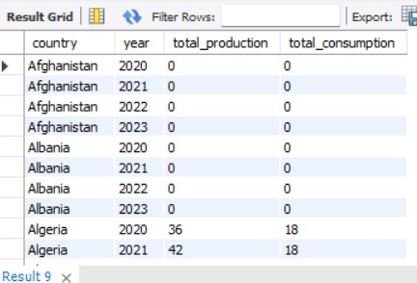
Compare energy production and consumption by country and year.
SELECT
production.country, production.year,
SUM(production.production) AS total_production, SUM(consumption.consumption) AS total_consumption
FROM
production JOIN
consumption
ON consumption.country = production.country AND consumption.year = production.year
GROUP BY
production.country, production.year ORDER BY
production.country, production.year;

Slide 12
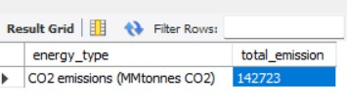
Which energy types contribute most to emissions across all countries?
SELECT
energy_type,SUM(emission) as total_emission from emission_3
GROUP BY energy_type order by total_emission desc limit 1;

Slide 13
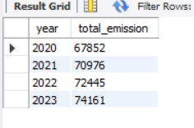
How have global emissions changed year over year?
Trend Analysis Over Time
SELECT
year,SUM(emission) AS total_emission FROM emission_3 GROUP BY year ORDER BY year ASC;

Slide 14
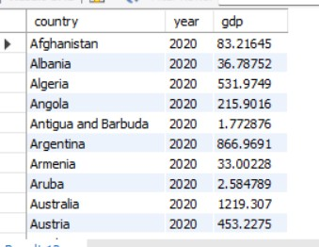
What is the trend in GDP for each country over the given years?
SELECT
country,year,SUM( value) AS gdp FROM gdp_3
GROUP BY country,year ORDER BY year ASC;

Slide 15
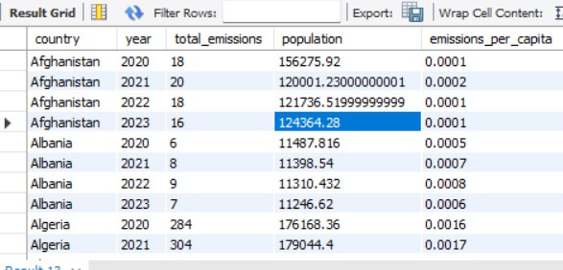
How has population growth affected total emissions in each country?
SELECT
e.country, e.year,
SUM(e.emission) AS total_emissions, SUM(p.value) AS population,
ROUND(SUM(e.emission) / NULLIF(SUM(p.Value), 0), 4) AS
emissions_per_capita FROM
emission_3 e JOIN
population p
ON e.country = p.countries AND e.year = p.year
GROUP BY
e.country, e.year ORDER BY
e.country, e.year;

Slide 16
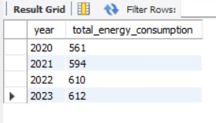
Has energy consumption increased or decreased over the years for major economies?
SELECT year,SUM(consumption) as total_energy_consumption
FROM consumption GROUP BY year;

Slide 17

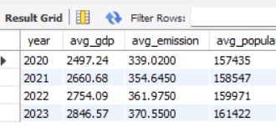
What is the global average GDP, emission, and population by year?
SELECT
e.year,
ROUND(SUM(g.value) / COUNT(DISTINCT g.country), 2) AS avg_gdp,
ROUND(SUM(e.emission) / COUNT(DISTINCT e.country), 4) AS
avg_emission,
ROUND(SUM(p.value) / COUNT(DISTINCT p.countries), 0) AS
avg_population FROM
emission_3 e JOIN
gdp_3 g ON e.country = g.country AND e.year = g.year
JOIN
population p ON e.country = p.countries AND e.year = p.year
GROUP BY
e.year ORDER BY
e.year;

Slide 18

Thank you

